Slide 1

Bluetooth Low Energy
Crash course in the Bluetooth Low Energy protocol
Edvin Holmseth
Norwegian University of Science and Thechnology
March 2022
Notes:
Agenda:
- BLE Protocol Basics – about 30-45min
- nRF51/nRF52 Hardware
- Nordic SoftDevices
- Nordic SDK (Software Development Kit)
- Q&A
This is by far not enough time to go through everything in the Bluetooth Low Energy Protocol(the core specification is 2772 pages long), but I’ll try to cover the most important topics.
If you have any questions during the presentation, then please save them until the Q&A session at the end

Slide 2

Bluetooth Low Energy
Wireless Personal Area Network technology
Operates in the 2.4GHz ISM (Industrial, Scientific and Medical) band
Specification defined by the Bluetooth SIG (Special Interest Group)
Optimized for low-power consumption
Racing to idle
Low range*
Low bandwidth*
Notes:
Racing to Idle: Transmit data in short bursts and then turn the radio off as often as possible.
Transmit power is usually between -30 and 0dBm
Cannot have high throughput and low power – these are opposites.
* May still be true, but significantly improved with later releases

Slide 3
Bluetooth modes
Term | Introduced | Means
BR | 1.1 (2002) | Basic Rate (1 Mbit/s)
EDR | 2.0 (2004) | Enhanced Data Rate (2 and 3 Mbit/s)
HS | 3.0 (2009) | High Speed (up to 24 Mbit/s )
LE | 4.0 (2010) | Low Energy (1 Mbit/s ultra low power)
Notes:
Nordic provides LE solutions only, we don’t provide BR, EDR or HS solutions
Current audio solutions (hands free systems, Bluetooth speakers, in car systems) all use “legacy Bluetooth” (EDR mostly), and Nordic does not compete in this space.
In the future audio might move to LE, but we are not yet there.

Slide 4
Bluetooth modes
Term | Introduced | Means
BR | 1.1 (2002) | Basic Rate (1 Mbit/s)
EDR | 2.0 (2004) | Enhanced Data Rate (2 and 3 Mbit/s)
HS | 3.0 (2009) | High Speed (up to 24 Mbit/s)
LE | 4.0 (2010) | Low Energy (1 Mbit/s ultra low power)
 | 4.1 (2013) | L2CAP CoC, Low Duty Cycle directed adv., multi role, Privacy 1.1, ++
 | 4.2 (2014) | LESC, DLE, Privacy 1.2, ++
 | 5.0 (2016) | High Speed(2 Mbit/s), Long Range, LE Adv. Extensions, LE Channel Selection Algorithm #2, Increased max power, ++
Notes:
All updates since 4.0 have been focused on the LE mode.
4.1: - L2CAP CoC allows higher transfer speeds by bypassing the GATT layer, and is used by things such as the IPSP profile for efficient transmission of IPv6 data over Bluetooth. Another use case is the Object Transfer Profile, used for transferring larger files.
Low duty cycle directed advertising allows low power advertising directed at a previously bonded device
Multi role allows a device to maintain both central and peripheral (master and slave) connections at the same time, allowing more sophisticated network topologies (such as connected mesh).
Privacy 1.1 provides resolvable private addresses, allowing a device to continuously change its BLE address to avoid being tracked, while still being capable of establishing a bond with other devices (the bonded device can “resolve” the changing address back to a static identifier, called the IRK)
4.2: - LE Secure connections allows asymmetric key exchange (aka private/public key scheme using diffie hellman). This makes the bonding procedure robust towards passive eavesdroppers (hackers that sniff the bonding procedure to steal the encryption keys). If a passkey is used the bonding will also be safe towards man in the middle attacks, making the BLE bonding virtually unbreakable (until someone finds a quick way to brute force 128-bit AES).
- DLE, or Data Length Extension, allows the link layer to extend the packet sizxe beyond 27 bytes, all the way up to 251 bytes, if both the master and slave support it.
Privacy 1.2 extends upon 1.1 by also allowing directed advertising with a resolvable address, so that a device can reconnect with a previously bonded device without being tracked
5.0: - High speed provides about double the transfer speed
Long range provides about 4 times the range, but can not be used at the same time as high speed.
LE advertising extensions allow about 8 times more data in advertise packets, and allow the advertisement of large data streams.
LE Channel Selection Algo 2 is intended primarily for the advertising extension feature, and adds more randomization to the channel selection mechanism. Without this there would be a large risk of interference between multiple devices using the adv extension feature at the same time to do things such as audio broadcasting.
Increased max power allows BLE devices to go up to 20dBm output power, versus only 10dBm in BT4.2 and below. Nordic currently doesn’t support more than 8 dBm (as of 2017), but it is possible to go up to 20dBm by adding an external power amplifier (at a cost to power consumption and BOM cost).

Slide 5
Bluetooth LE Architecture
HID over GATT
Proximity
Battery
Thermometer
Heart Rate
Blood Pressure
Proprietary
Application
…
Split into three main building blocks
Application
User application interfacing with the Bluetooth protocol stack
Host
Upper layers of the Bluetooth protocol stack
Controller
Low layers of the Bluetooth protocol stack, including the radio
GATT
GATT
GAP
GAP
SMP
ATT
SMP
Host
ATT
Host
L2CAP
L2CAP
Host Controller Interface (HCI)
Host Controller Interface (HCI)
Controller
Controller
Link Layer (LL)
Link Layer (LL)
Physical Layer (PHY)
Physical Layer (PHY)
Notes:
I’ll try describe the function of the individual layers and how they interact with each other.
We will start at the bottom and then work ourselves up through the layer until we reach the top application layer.

Slide 6
Bluetooth LE Architecture
HID over GATT
Proximity
Battery
Thermometer
Heart Rate
Blood Pressure
Proprietary
Application
…
Split into three main building blocks
Application
User application interfacing with the Bluetooth protocol stack
Host
Upper layers of the Bluetooth protocol stack
Controller
Low layers of the Bluetooth protocol stack, including the radio
GATT
GAP
Host
ATT
SMP
L2CAP
Host Controller Interface (HCI)
Controller
Link Layer (LL)
Physical Layer (PHY)
Notes:
I’ll try describe the function of the individual layers and how they interact with each other.
We will start at the bottom and then work ourselves up through the layer until we reach the top application layer.

Slide 7
Physical Layer(PHY)
Host Controller Interface
Controller
Link Layer (LL)
Physical Layer (PHY)
2.4 GHz ISM band
Divided into 40 channels from 2.400GHz to 2.4835GHz
Frequency Hopping Spread Spectrum(FHSS)
Channel 37, 38 and 39 are used for advertising
Remaining channels used during connections
Notes:
The ISM band is used since it can be used world-wide without having to obtain licenses
Frequency Hopping Spread Spectrum(FHSS), i.e. hops from channel to channel in order to minimize interference from other transmitters, like WIFI.
The 3 advertising channels are selected on purpose to avoid the most popular WiFi channels (1, 6 and 11)

Slide 8
Link Layer (LL)
Host Controller Interface
Controller
Link Layer (LL)
Physical Layer (PHY)
Combination of hardware and software.
Interfaces directly with the PHY layer and responsible for:
Framing the data from the upper layers in a link layer packet(BLE packet).
Meeting the timing requirements of the BLE specification.
Encryption of the link
CRC generation and verification
Defines the following roles:
Advertiser: A device sending advertisement packets
Scanner: A device scanning for advertisement packets
Master: A device that initiates a connection and manages it later
Slave: A device that accepts a connection request and follows the master’s timing
Notes:
Implemented in both hardware and software. Only layer that has real-time constraints.
Advertiser: A device sending advertisement packets
Scanner: A device scanning for advertisement packets
Master: A device that initiates a connection and manages it later
Slave: A device that accepts a connection request and follows the master’s timing

Slide 9

Network topology
Host Controller Interface
Controller
Link Layer (LL)
Physical Layer (PHY)
Master
Scanner
Slave
Master
Slave
Advertiser
Slave
Slave
Notes:
Advertisement packets serve two purposes:
Broadcast data without the overhead needed during a connection
Make its presence known to centrals so that they can connect
-A device can act as central and peripheral at the same time
-A central can be connected to multiple peripherals (up to 8 at the time) – S130 and S132
-A peripheral can be connected to multiple centrals

Slide 10
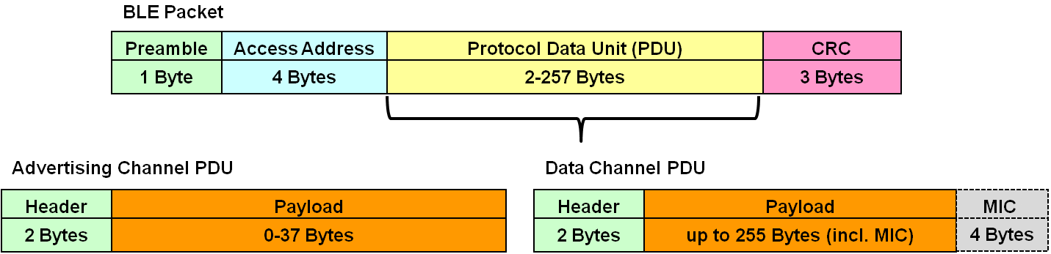
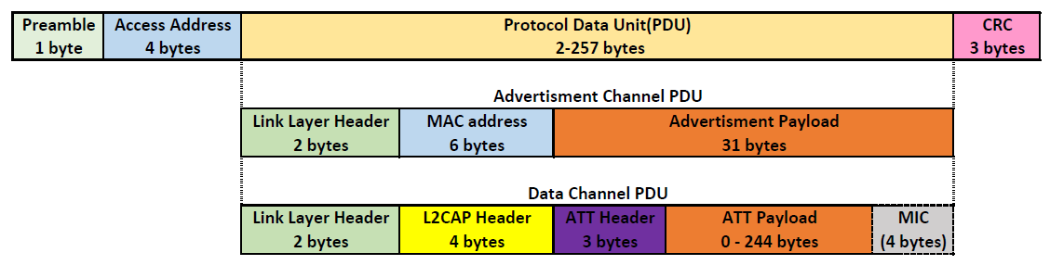
BLE Packet
Host Controller Interface
Controller
Link Layer (LL)
Physical Layer (PHY)
BLE has one packet structure and two packet types:
Advertisement packets
BT 4.0: (31 byte payload + optional 31 byte in scan response packet)
BT 5.0: (255 byte payload with advertising extensions)
Data packets
BT 4.0: (27 byte payload, only 20 byte available for user data)
BT 4.2: (251 byte payload, 244 byte available for user data)
Notes:
Advertisement packets can be further classified
Connectability
Scanability
Directability
Advertisement packets serve two purposes:
Broadcast data without the overhead needed during a connection
Make its presence known to centrals so that they can connect
Connectability
Connectable: Scanner may issue a connection request to the
Non-connectable:
Scanability
Scanable: Scanner may issue a scan request
Non-scanable: Scanner may not issue a scan
3) Directability
Directed – Adv.packet only contains the advertisers address and the target scanner address, No user data. Always connectable
Undirected – Adv.packet has no target, i.e. broadcasting. May contain user data.
Also note that devices can filter advertisement packets in the link layer by adding devices to a so-called “white-list” and be

Slide 11
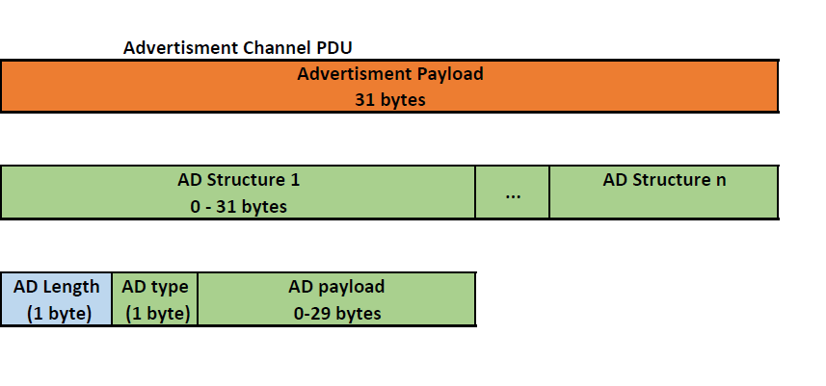
Advertisement Packet
Advertisement payload contains one or more advertisement structures.
Each structure consists of:
AD Length: AD type + AD Payload in bytes
AD Type: The type of the payload data.
AD Payload: The payload data.
Commonly used AD types
0x01 - Flags
0x02 - Incomplete List of 16-bit Service Class UUID
0x06 - Incomplete List of 128-bit Service Class UUIDs
0x08 - Shortened Local Name
0x09 - Complete Local Name
0xFF - Manufacturer Specific Data
Notes:
https://www.bluetooth.com/specifications/assigned-numbers/generic-access-profile
Flags - “The Flags data type shall be included when any of the Flag bits are non-zero”. Since the Softdevice only supports Bluetooth LE the "BR/EDR not supported"-bit must always be set and hence, the AD Flags must be included.
LE Limited Discoverable Mode, BR/EDR not supported – LE device will only advertise for a limited time, e.g. 30 seconds and then stop. In order to start advertising after the 30 s , the device must be reset(power-cycled) to
LE General Discoverable Mode, BR/EDR not supported.

Slide 12
Advertising & Scanning
Host Controller Interface
Controller
Link Layer (LL)
Physical Layer (PHY)
Scanner scan interval = 50 ms
Scanner scan window = 25 ms
Scanning on channel 37
Scanning on channel 38
Scanning on channel 39
S
0 ms
25 ms
50 ms
75 ms
100 ms
125 ms
150 ms
A
0 ms
20 ms
40 ms
60 ms
80 ms
100 ms
120 ms
140 ms
Advertising on 37, 38 and 39
Advertiser advertising, interval = 20 ms
Notes:
Advertisement interval: How often the advertising device transmits the advertisement packet
Scan interval and window: How often the central scans and how long.
Scanner and advertiser not synchronized -> advertisement packets will only be received when scan window and adv.interval overlaps.

Slide 13
Connection Establishment
Host Controller Interface
Controller
Link Layer (LL)
Physical Layer (PHY)
Master starts scanning for advertising devices that are connectable
Master initiates the connection process based on data in advertisment packet
When a suitable advertising device is found, the master sends a connection request packet containing the following:
Frequency hop increment: Which channel that should be used for the next connection event
Connection interval: The time between two consecutive connection events
Slave latency: The number of connection events that a slave can choose to skip with out risking disconnecting
Connection supervision timeout: Length of time the master will wait for a response from the slave before the connection is terminated.
Notes:
Frequency Hop Increment: Which channel that should be used for the next connection event
Connection interval: The time between two consequtive connection events
Slave latency: The number of connection events that a slave can choose to skip with out risking disconnecting
Connection supervision timeout: Length of time the master will wait for a response from the slave before the connection is terminated. Even though there is no data to be sent, the connection MUST be kept alive by sending an empty packet.

Slide 14
Connection
Host Controller Interface
Controller
Link Layer (LL)
Physical Layer (PHY)
Master sends first, slave responds
Multiple data packets can be sent per connection event occurring at each connection interval
Connection interval can be from 7.5 ms to 4 seconds
Slave
R
T
R
T
R
T
R
T
T
R
T
X
X
X
X
X
X
X
X
X
X
X
Slave latency
T
R
T
R
T
R
T
R
T
T
R
Master
X
X
X
X
X
X
X
X
X
X
X
connection interval
connection interval
connection interval
Notes:
Important to note that the link layer acts as a reliable data bearer. All packets received are checked against a 24-bit CRC and retransmissons are requested when errors are detected.
No upper limit to the number of re-transmissions, i.e. packet will be re-sent until its received successfully.

Slide 15
Bluetooth LE Architecture
HID over GATT
Proximity
Battery
Thermometer
Heart Rate
Blood Pressure
Proprietary
Application
…
Split into three main building blocks
Application
User application interfacing with the Bluetooth protocol stack
Host
Upper layers of the Bluetooth protocol stack
Controller
Low layers of the Bluetooth protocol stack, including the radio
GATT
GAP
Host
ATT
SMP
L2CAP
Host Controller Interface (HCI)
Controller
Link Layer (LL)
Physical Layer (PHY)
Notes:
I’ll try describe the function of the individual layers and how they interact with each other.
We will start at the bottom and then work ourselves up through the layer until we reach the top application layer.

Slide 16
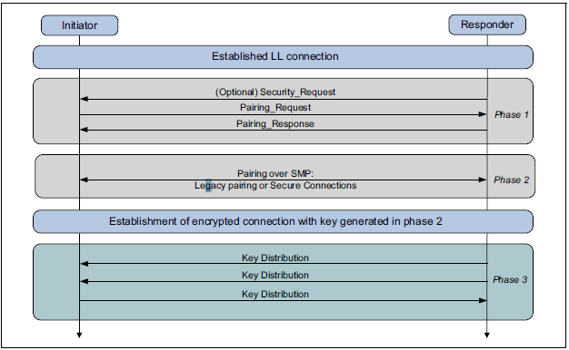
Bluetooth Paring and Bonding
GATT
GAP
Host
ATT
SMP
L2CAP
Pairing (Phase 1 & 2)
Temporary security encryption key, the Short Term Key(STK) is generated and used to encrypt the link
Bonding (Phase 1 & 2 + Phase 3)
A sequence of pairing followed by the generation and exchange of a Long Term Key(LTK)
Encryption re-establishment
Long Term Key(LTK) used to re-encrypt connection at a later time
Notes:
Paring can therefore create a secure link that lasts for the duration of the connection.
Bonding on the other hand will allow you to secure the link for the lifetime of the device. Given that none of the devices deletes its LTK
Bonding can only be performed if the link has been secured with the LTK

Slide 17
Generic Access Profile(GAP)
GATT
GAP
Host
ATT
SMP
L2CAP
Defines procedures on how devices discover, connect and present information to each other.
Roles
Peripheral (Link Layer Slave)
Central (Link Layer Master )
Broadcaster (Link Layer advertiser)
Observer (Link Layer scanner)
Security
Pairing and creating bonds with peer devices
Attribute access security requirements
Privacy and address control
Notes:
GAP: Top-most control layer in BLE
SMP: security Manager (Protocol?)
GAP service contains:
Device name characteristic : Contains a user readable device name, “My BLE Device”
Apperance characteristic : 16-bit value that places the device in a generic category( phone, computer, keyboard) etc. Typically used by the GATT client to display an icon.
Peripheral Preferred Connection Parameters characteristic: Central dictates the connection parameters, but this characteristic can be read so that the master can change the conn params to be favorable for the peripheral.
Privacy control and Address control:
Static address
Non-resolvable private address
Resolvable private address

Slide 18
GAP Operations
GATT
GAP
Host
ATT
SMP
L2CAP
Set advertisement data
Start/stop advertising
Start/stop scanning
Connect/disconnect to a device
Update Connection Parameters
Encrypt link

Slide 19
Network topology
GATT
GAP
Host
ATT
SMP
L2CAP
Observer Scanner
Central Master
Peripheral
Central
BroadcasterAdvertiser
PeripheralSlave
Peripheral
Notes:
So if we revisit the network topology slide from the link layer, then it would look something like this seen from the GAP layer

Slide 20
Generic Attribute Profile (GATT)
GATT
GAP
Host
ATT
SMP
L2CAP
Defines procedures on how to exchange data over a BLE connection
Uses the Attribute Protocol(ATT) as its transport layer
Uses a client-server architecture, like the Attribute Protocol(ATT)
Attributes organized hierarchically
Services
Characteristics
Descriptors

Slide 21
Services, Characteristics and Descriptors
GATT
GAP
Host
ATT
SMP
L2CAP
Services
Group of characteristics
Characteristic
Data containers, e.g. temperature, battery voltage
Descriptor
Additional meta-data of the characteristic, e.g. notifications and indications
GATT Server
Service
Characteristic
Value
Descriptor
Characteristic
Value
Descriptor
Notes:
The attributes in a GATT server are grouped into services, each of which can contain zero or more characteristics.
Each characteristic within a service can contain zero or more descriptors. Descriptor can also be used to enable and disable notifications/indications.
Conceptually, a GATT service can be viewed as a class in a object oriented programming language with several member variables that can be read and written to, depending on the permissions that are given.

Slide 22
Services, Characteristics and Descriptors cont’d
GATT
GAP
Host
ATT
SMP
L2CAP
Services, characteristics and descriptors all have an UUID
UUID – Universal Unique Identifier
16-bit short UUID using Bluetooth Base 0000XXXX-0000-1000-8000-00805F9B34FB
128-bit UUID
In addition Characteristics and Descriptors have
Permissions – Read, Write.
Value – data that can be read/written by client
Notes:
Attributes are addressable pieces of information

Slide 23
GATT Operations
GATT
GAP
Host
ATT
SMP
L2CAP
Service and Characteristic Discovery
Writing to Characteristics and Descriptors
Reading from Characteristics and Descriptors
Server initiated updates
Characteristic Value Notification:
Characteristic Value Indication:
Notes:
GATT client does not have knowledge of the attributes present on the GATT server. Service and characteristic discovery must be performed.
Server initiated updates: Alerts the client that a characteristics value has changed so that the client does not have to poll the server all the time. Notification /indication contains both the handle and the characteristic value.
Notification: Client is not required to ACK a Notification
Indication: Client must confirm that the indication was received before the server can send further indications. Client must ACK.

Slide 24
Service Discovery
GATT
GAP
Host
ATT
SMP
L2CAP
Client does not know which services/characteristics/descriptors the server has implemented.
Performs Service discovery and stores copy of the GATT server structure.
Uses copy as a lookup table when reading/writing to characteristics or descriptors
Discover services
GATT Client
GATT Server
Copy of GATT server table
Service
Characteristic
Value
UUIDs, permissons for 1st Service
Descriptor
Service
Characteristic
UUIDs, permissons for 2nd Service
Value
Descriptor
Notes:
CCCD = Client Characteristic Configuration Descriptor

Slide 25
GATT Transaction
GATT
GAP
Host
ATT
SMP
L2CAP
GATT Client
GATT Server
Copy of GATT server table
Request
Service
Response
Characteristic
Value
Descriptor
Notification/ Indication
Characteristic
Value
Descriptor
Notes:
GATT Client -> Central, Master
GATT Server -> Peripheral Slave
Request-response flow
CCCD = Client Characteristic Configuration Descriptor

Slide 26
Client Characteristic Configuration Descriptor (CCCD)
GATT
GAP
Host
ATT
SMP
L2CAP
Notification and indication switch
Two-bit field value
0x01: Enables Notifications
0x02: Enables Indications
Client can turn on/off Notifications/Indications by writing to the CCCD.
GATT Client
GATT Server
Copy of GATT server table
Service
Characteristic
Notification
Characteristic Value
CCCD 0x00
CCCD 0x01
Enable Noifications
Notes:
CCCD = Client Characteristic Configuration Descriptor

Slide 27
GATT table
GATT
GAP
Host
ATT
SMP
L2CAP
Handle | UUID (Type) | Value (Type)
0x0001 | 0x2800 (Service) | 0x1800 (GAP Service)
0x0002 | 0x2803 (Characteristic) | {0x0A, 0x0003, 0x2A00}
0x0003 | 0x2A00 (Device Name) | “Example Device”
0x0010 | 0x2800 (Service) | 0x1801 (GATT Service)
0x0100 | 0x2800 (Service) | 0x180A (Battery State Service)
0x0101 | 0x2803 (Characteristic) | {0x02, 0x0102, 0x2A19}
0x0102 | 0x2A19 (Battery Level) | 0x04
0x0200 | 0x2800 (Service) | 0x5AB20001-B355-4D8A-96EF-2963812DD0B8
0x0201 | 0x2803 (Characteristic) | {0x12, 0x0202, 0x5AB2FF01-B355-4D8A-96EF-2963812DD0B8}
0x0202 | 0x5AB2FF01-B355-4D8A-96EF-2963812DD0B8 (Proprietary Temperature Characteristic) | 0x028A
0x0203 | 0x2904 (Characteristic Format) | {0x0E, 0xFE, «Celsius», «Outside»}
0x0204 | 0x2901 (Characteristic User Description) | “Outside Temperature”
0x0205 | 0x2902 (Client Characteristic Configuration Descriptor) | 0x0000
Battery State Service
Proprietary Thermometer Service
Notes:
This what an actual GATT or attribute table would look like.
I’ll not explain in detail how the GATT table is built, but the specification explains this strict hierarchy in detail. Services and characteristics will always have a “declaration”-attribute associated with them.
The handle value is incremented for each attribute that is added to the table

Slide 28
Bluetooth LE Architecture
HID over GATT
Proximity
Battery
Thermometer
Heart Rate
Blood Pressure
Proprietary
Application
…
Split into three main building blocks
Application
User application interfacing with the Bluetooth protocol stack
Host
Upper layers of the Bluetooth protocol stack
Controller
Low layers of the Bluetooth protocol stack, including the radio
GATT
GAP
Host
ATT
SMP
L2CAP
Host Controller Interface (HCI)
Controller
Link Layer (LL)
Physical Layer (PHY)
Notes:
I’ll try describe the function of the individual layers and how they interact with each other.
We will start at the bottom and then work ourselves up through the layer until we reach the top application layer.

Slide 29
Application
Proprietary
HID over GATT
Proximity
Battery
Thermometer
Heart Rate
Blood Pressure
…
Application
Profile:
Collection of services
Selects required features from GAP and GATT
Use-case specific profiles
Bluetooth SIG defined, e.g. Heart Rate Profile ( Heart Rate Service + Device Information Service)
Vendor-specific (proprietary), Apple iBeacon, Google Eddystone
Key to interoperability

Slide 30
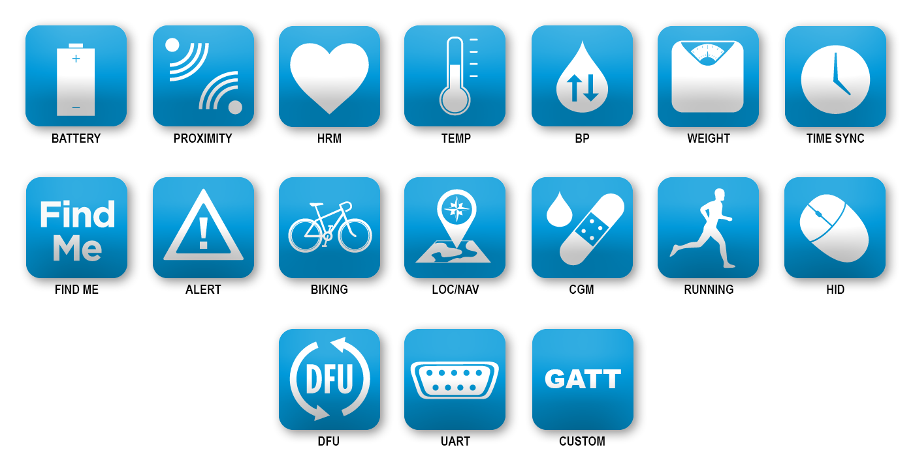
Application
Proprietary
HID over GATT
Proximity
Battery
Thermometer
Heart Rate
Blood Pressure
…
Application
Notes:
An important distinction between Bluetooth LE and legacy Bluetooth (BR, EDR and HS), is that the profiles are taken out of the stack and put into the application space.
This allows the creation of a huge number of profiles, without requiring the BT stack to contain them all, and it allows the user to easily define their own custom profiles (aka custom GATT profile).
Rather than everyone using their own profile like in legacy (everyone doing their own unique applications used the serial profile), people can now make their own customized ones.

Slide 31
Bluetooth Low Energy
Crash course in the Bluetooth Low Energy protocol
Edvin Holmseth
Norwegian University of Science and Thechnology
March 2022
Notes:
Agenda:
- BLE Protocol Basics – about 30-45min
- nRF51/nRF52 Hardware
- Nordic SoftDevices
- Nordic SDK (Software Development Kit)
- Q&A
This is by far not enough time to go through everything in the Bluetooth Low Energy Protocol(the core specification is 2772 pages long), but I’ll try to cover the most important topics.
If you have any questions during the presentation, then please save them until the Q&A session at the end

